Slide 1
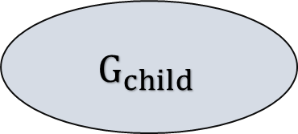
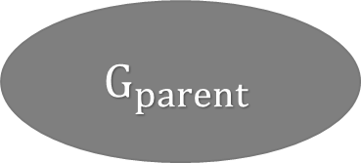
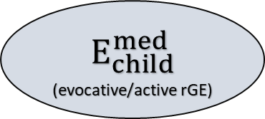
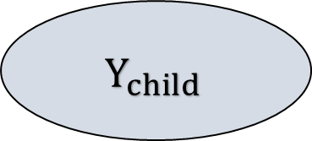

$$G_{parent}$$
“Genetic nurture”
$$G_{child}$$
$$E_{child}^{conf}$$
“passive rGE”
“direct effect”
$$E_{child}^{med}$$
_{(evocative/active rGE)}
$$Y_{child}$$

